Slide 1
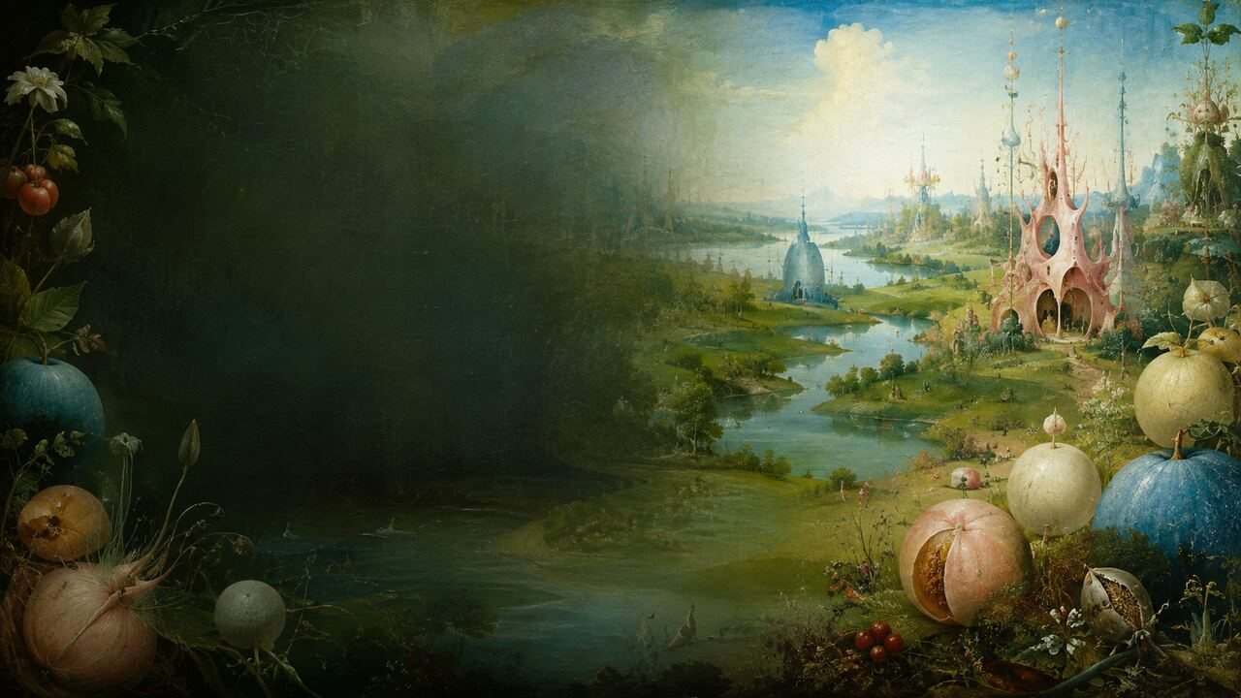
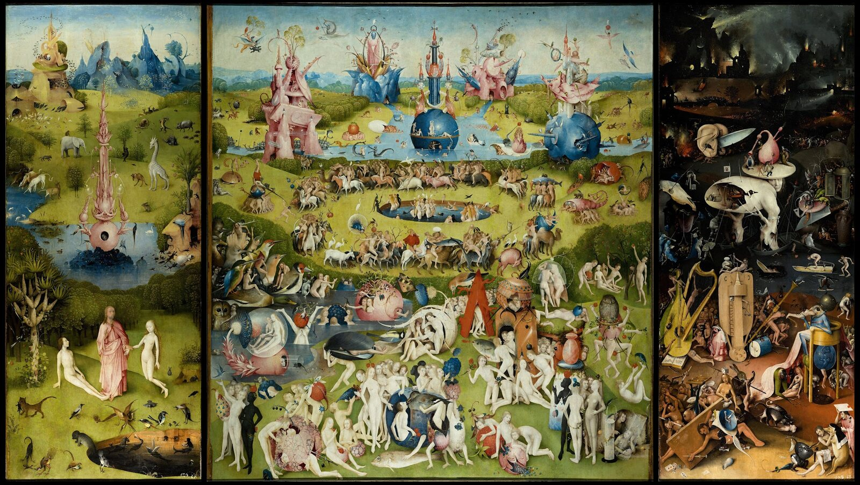
MASTERS & MASTERPIECES | HIERONYMUS BOSCH
THE GARDEN OF EARTHLY DELIGHTS
Why must temptation look so beautiful?
c. 1490–1500 / BRCP: 1501–1505 | Museo del Prado
Why must temptation look so beautiful?
MASTERS & MASTERPIECES
Notes:
Close The Garden of Earthly Delights and you see a quiet grey-green world before humanity. Open the shutters and nearly four metres of surface erupt into naked bodies, enormous fruit, hybrid creatures, musical instruments, and punishment. Bosch's deepest riddle is not simply what each monster means. It is this: if the triptych warns against sensual excess, why must temptation be so beautiful? We will follow the work's original opening sequence, moving from Creation into Eden, through the central garden, and finally into musical Hell.
[Sources]
- https://docs.google.com/document/d/1Vjy7zvqamZy86taq1dsKhdKd97FuGD-3J8yaHpLhkm0/edit
- https://www.museodelprado.es/en/the-collection/art-work/the-garden-of-earthly-delights-triptych/02388242-6d6a-4e9e-a992-e1311eab3609
- Background: OpenAI ImageGen, generated from the user's Bosch-inspired visual direction; not a reproduction of an existing artwork.

Slide 2
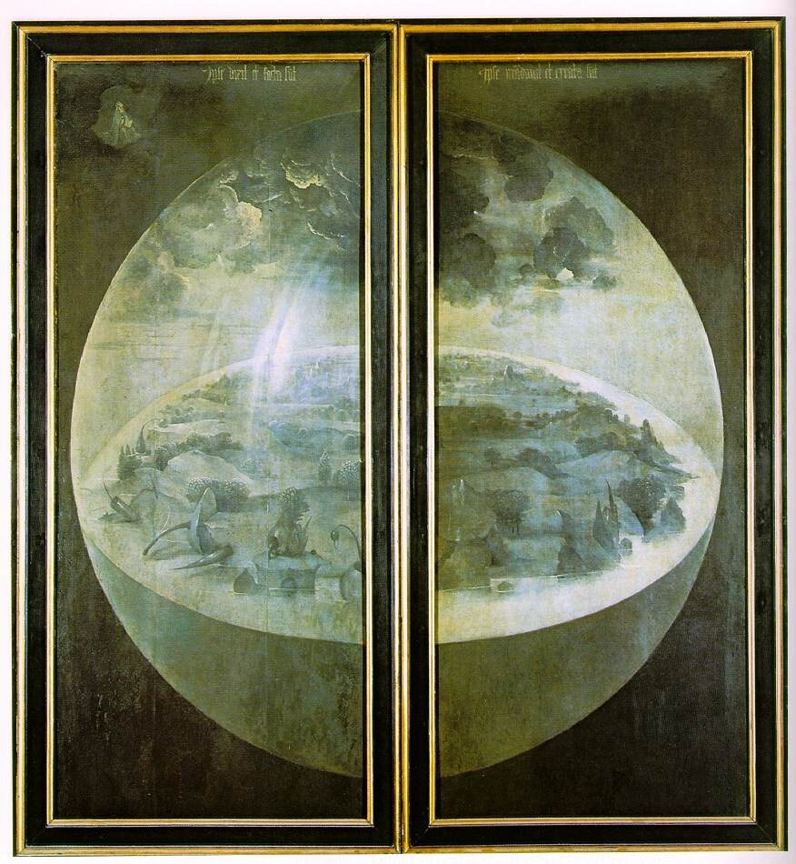
01 | THE CLOSED WORLD
02
The Third Day: Humanity Has Not Yet Appeared
The silence outside prepares the visual explosion within.
Grisaille lowers the world into grey-green
A transparent sphere encloses land, water, and plants
The Creator is astonishingly small
Exterior shutters | The Creation | public-domain reproduction
The silence outside prepares the visual explosion within.
MASTERS & MASTERPIECES
Notes:
Begin with the closed shutters rather than the famous central panel. In grisaille, a transparent sphere encloses land, water, and plants. Humanity, the sun, and the moon have not yet appeared, and the Creator in the upper left is astonishingly small. The Latin inscription echoes Psalm 33:9: he spoke, and it came to be; he commanded, and it stood firm. The exterior is usually read as the third day of Creation, but that is a strong art-historical interpretation, not an instruction left by Bosch.
[Sources]
- https://docs.google.com/document/d/1Vjy7zvqamZy86taq1dsKhdKd97FuGD-3J8yaHpLhkm0/edit
- https://www.museodelprado.es/en/the-collection/art-work/the-garden-of-earthly-delights-triptych/02388242-6d6a-4e9e-a992-e1311eab3609
- Background: OpenAI ImageGen, generated from the user's Bosch-inspired visual direction; not a reproduction of an existing artwork.

Slide 3
02 | OPENING THE WINGS
03
From Silent World to Sensory Flood
Complete open triptych | public-domain reproduction
Opening the shutters is the work's first narrative event.
Height: 185.8 cm
Open width: about 325.5 cm
Eden | Earthly Delights | Musical Hell
Opening the shutters is the work's first narrative event.
MASTERS & MASTERPIECES
Notes:
When the shutters open, grey-green silence becomes pink, sky blue, tender green, flesh, and fire. On the left are God, Adam, and Eve. The center fills with fruit, birds, riders, glass-like spheres, and bodily games. The right ends in darkness, ice, burning cities, and punishment. The triptych is 185.8 centimeters high and about 325.5 centimeters wide when open. It was never meant to be only a flat online image. The physical change from closed restraint to open excess is the viewer's first encounter with its argument.
[Sources]
- https://docs.google.com/document/d/1Vjy7zvqamZy86taq1dsKhdKd97FuGD-3J8yaHpLhkm0/edit
- https://www.museodelprado.es/en/the-collection/art-work/the-garden-of-earthly-delights-triptych/02388242-6d6a-4e9e-a992-e1311eab3609
- Background: OpenAI ImageGen, generated from the user's Bosch-inspired visual direction; not a reproduction of an existing artwork.

Slide 4
03 | SACRED FORM, SECULAR PALACE
04
Bosch Was Not an Isolated Hallucinatory Genius
He knew religious and courtly rules well enough to bend them.
c. 1450
1486/87
1504
1517
c. 1450 | born into a family of painters
1486/87 | joined the Brotherhood of Our Lady
1504 | received a major court commission
1517 | the triptych recorded in the Nassau Palace
Original title, patron, contract, and first function remain unknown
He knew religious and courtly rules well enough to bend them.
MASTERS & MASTERPIECES
Notes:
Bosch was born Jheronimus van Aken around 1450 in 's-Hertogenbosch, into a family associated with painting. He later signed with an abbreviation of his hometown: Bosch. His membership in the Brotherhood of Our Lady and a major court commission in 1504 show a professional artist embedded in urban religion and elite networks, not an isolated visionary. The triptych's contract and original title are lost. Yet a travel account from 1517 securely places it in the Nassau Palace in Brussels, where informed courtly viewers could be entertained and morally challenged at once.
[Sources]
- https://www.museodelprado.es/en/the-collection/artist/hieronymus-bosch/c9716e4a-4c24-44dd-ac65-44bc4661c8b5
- https://www.huygens.knaw.nl/en/resources/boschdoc-2/
- https://www.museodelprado.es/en/the-collection/art-work/the-garden-of-earthly-delights-triptych/02388242-6d6a-4e9e-a992-e1311eab3609
- Background: OpenAI ImageGen, generated from the user's Bosch-inspired visual direction; not a reproduction of an existing artwork.

Slide 5
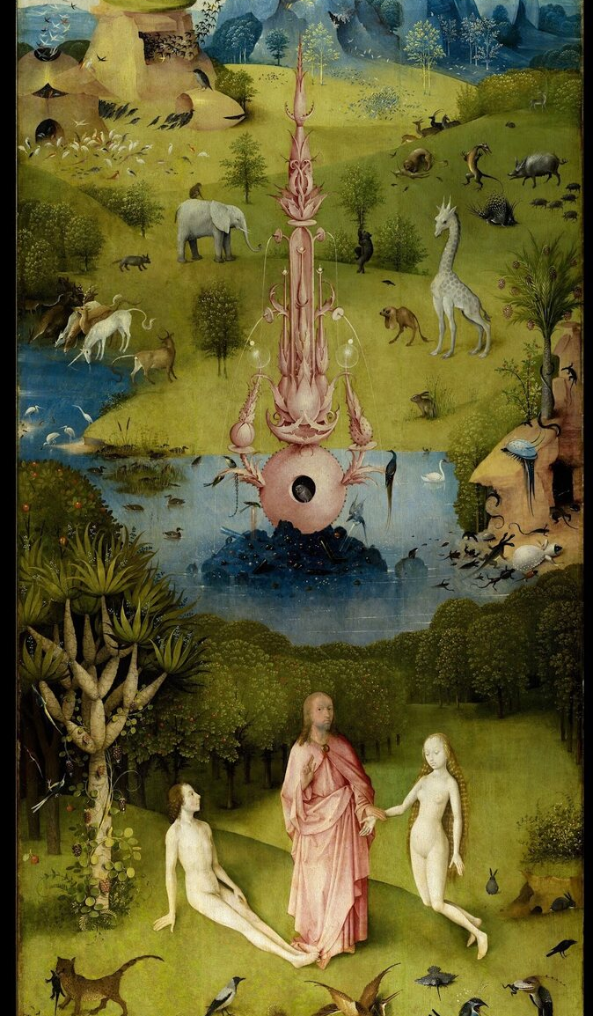
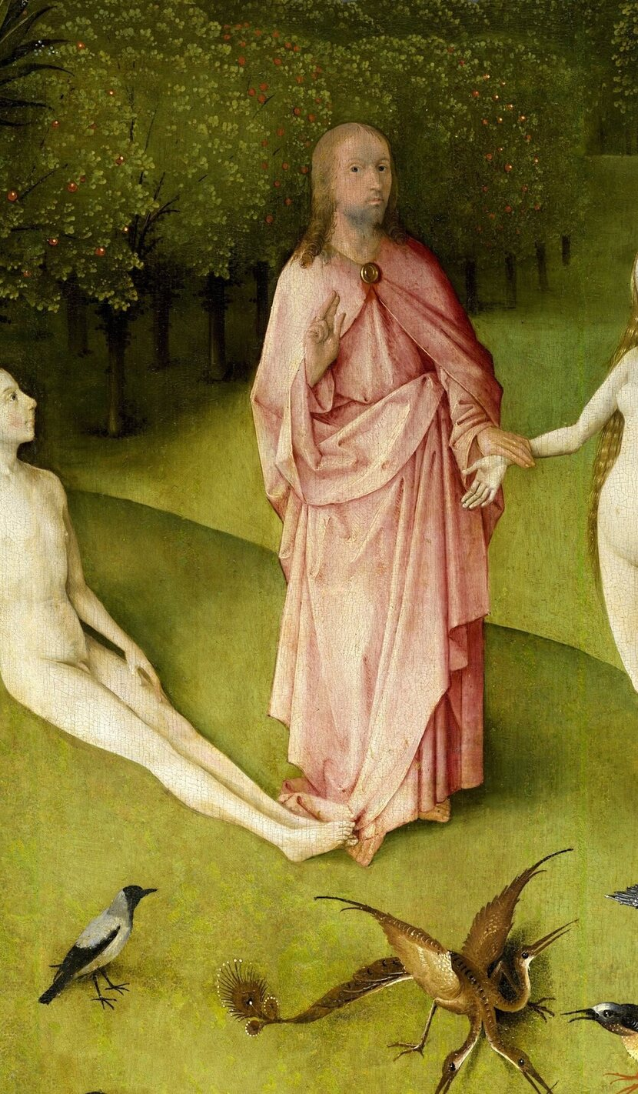
04 | EDEN
05
The First Gaze Is Already Unstable
Bosch turns looking into the first event of human history.
God takes Eve by the wrist and presents her
Adam raises his eyes toward Eve
Blessing, recognition, and desire overlap
Left panel + God presents Eve to Adam
Bosch turns looking into the first event of human history.
MASTERS & MASTERPIECES
Notes:
In the foreground of Eden, a youthful, Christ-like God takes Eve by the wrist and brings her before the reclining Adam. Hands, gazes, and posture form a chain of relationship. Adam looks up at Eve. The look may suggest wonder, recognition, or the beginning of desire; the painting does not settle his psychology. What matters is that Bosch makes looking itself an event. The hundreds of bodies pursuing one another in the central panel seem to expand from this first charged exchange.
[Sources]
- https://docs.google.com/document/d/1Vjy7zvqamZy86taq1dsKhdKd97FuGD-3J8yaHpLhkm0/edit
- https://www.museodelprado.es/en/the-collection/art-work/the-garden-of-earthly-delights-triptych/02388242-6d6a-4e9e-a992-e1311eab3609
- Background: OpenAI ImageGen, generated from the user's Bosch-inspired visual direction; not a reproduction of an existing artwork.

Slide 6
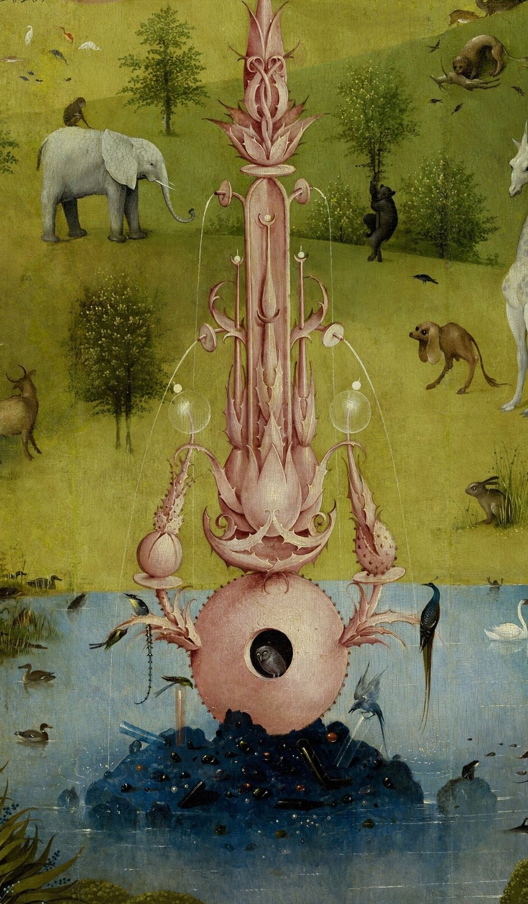
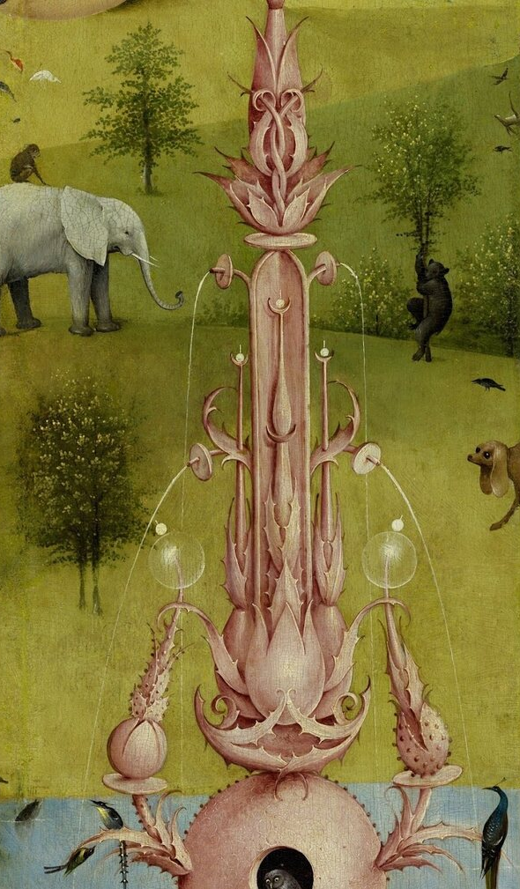
05 | AN UNSTABLE PARADISE
06
Dark Eyes Inside the Fountain of Life
Predation and unease already inhabit Eden's order.
The pink fountain combines plant, mineral, body, and architecture
The owl has no single universal meaning
Giraffe, elephant, predators, prey, and hybrids coexist
Fountain and owl + animals and predation in Eden
Predation and unease already inhabit Eden's order.
MASTERS & MASTERPIECES
Notes:
The pink Fountain of Life occupies Eden's center, combining plant, mineral, architecture, and body. An owl watches from a dark opening. In medieval contexts the owl may suggest darkness, blindness, evil, or silence, but no universal symbol dictionary can settle this image. Around it appear an elephant, giraffe, unicorn-like creatures, strange fish, and acts of predation. If this is a perfect paradise before the Fall, why is death already present? Bosch offers no answer. He places instability precisely where the composition appears most ordered.
[Sources]
- https://docs.google.com/document/d/1Vjy7zvqamZy86taq1dsKhdKd97FuGD-3J8yaHpLhkm0/edit
- https://www.museodelprado.es/en/the-collection/art-work/the-garden-of-earthly-delights-triptych/02388242-6d6a-4e9e-a992-e1311eab3609
- Background: OpenAI ImageGen, generated from the user's Bosch-inspired visual direction; not a reproduction of an existing artwork.

Slide 7
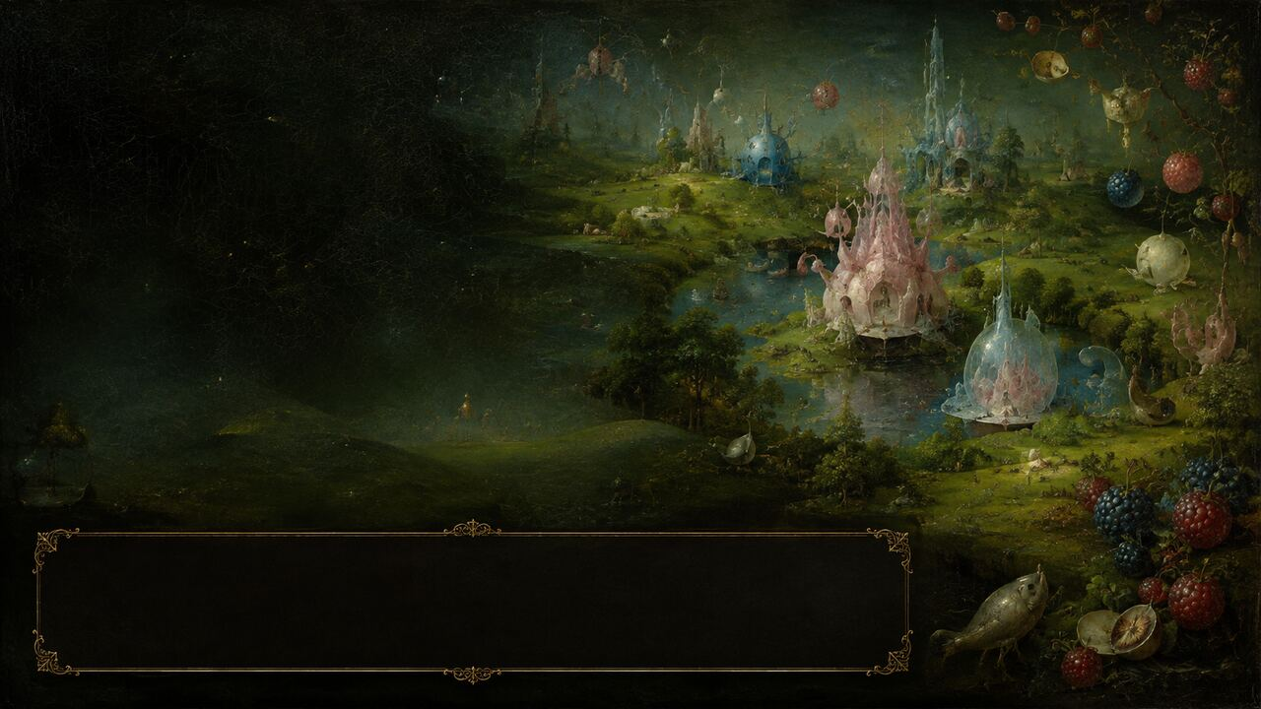
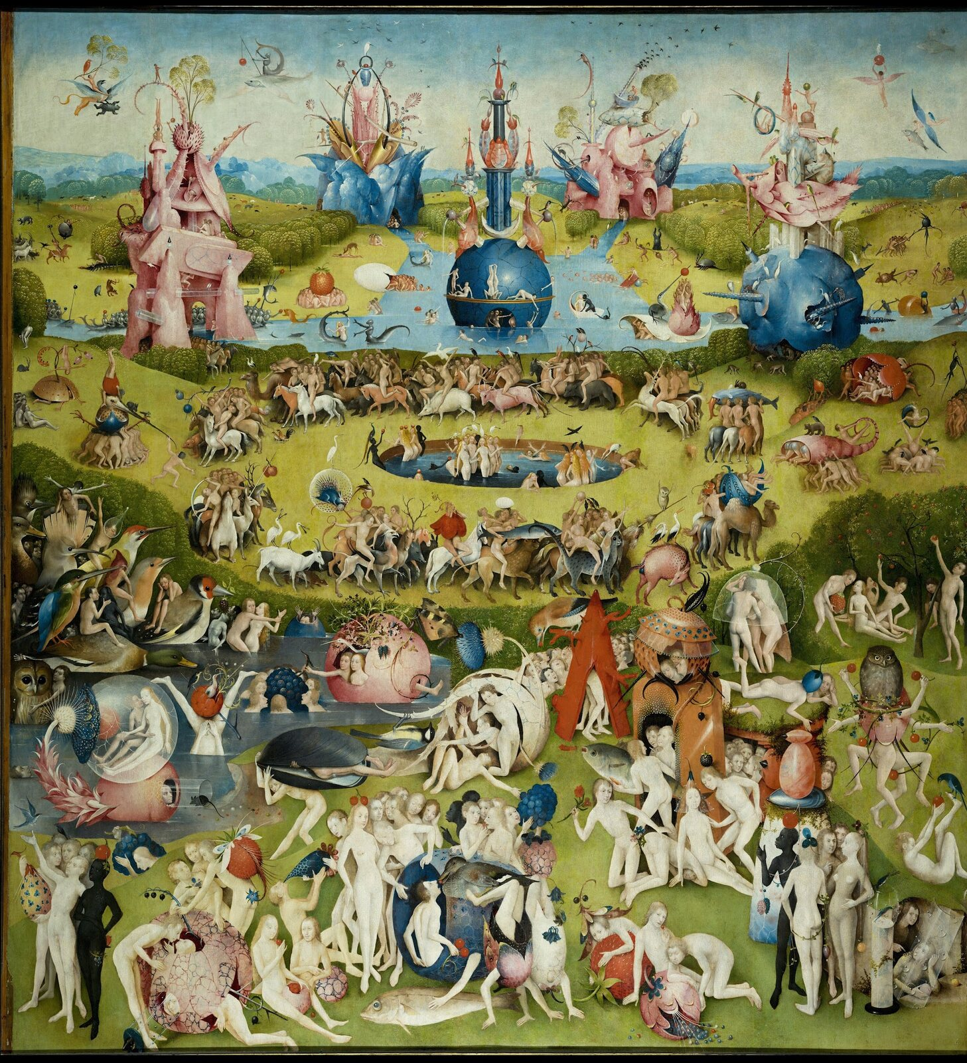
06 | THE CENTRAL GARDEN
07
A World Beautiful Enough to Lower Our Guard
Once God disappears, desire becomes the organizing force.
Young nude figures pick, swallow, ride, and touch
No obvious old age, work, illness, or institutions
Pleasure looks painless, yet nothing can stop
Center panel | Earthly Delights
Once God disappears, desire becomes the organizing force.
MASTERS & MASTERPIECES
Notes:
The central panel continues Eden's horizon, water, and strange rock formations, as though paradise has grown to the right. But God has disappeared. Nearly everyone is young and naked. There are no obvious elderly people, children, homes, work, illness, or institutions. Figures pick and swallow fruit, touch one another, ride animals, bathe, and enter shells, plants, and transparent enclosures. The absence of visible suffering makes interpretation difficult. Is this unfallen humanity, or sensual excess before anyone can feel its consequences?
[Sources]
- https://docs.google.com/document/d/1Vjy7zvqamZy86taq1dsKhdKd97FuGD-3J8yaHpLhkm0/edit
- https://www.museodelprado.es/en/the-collection/art-work/the-garden-of-earthly-delights-triptych/02388242-6d6a-4e9e-a992-e1311eab3609
- Background: OpenAI ImageGen, generated from the user's Bosch-inspired visual direction; not a reproduction of an existing artwork.

Slide 8
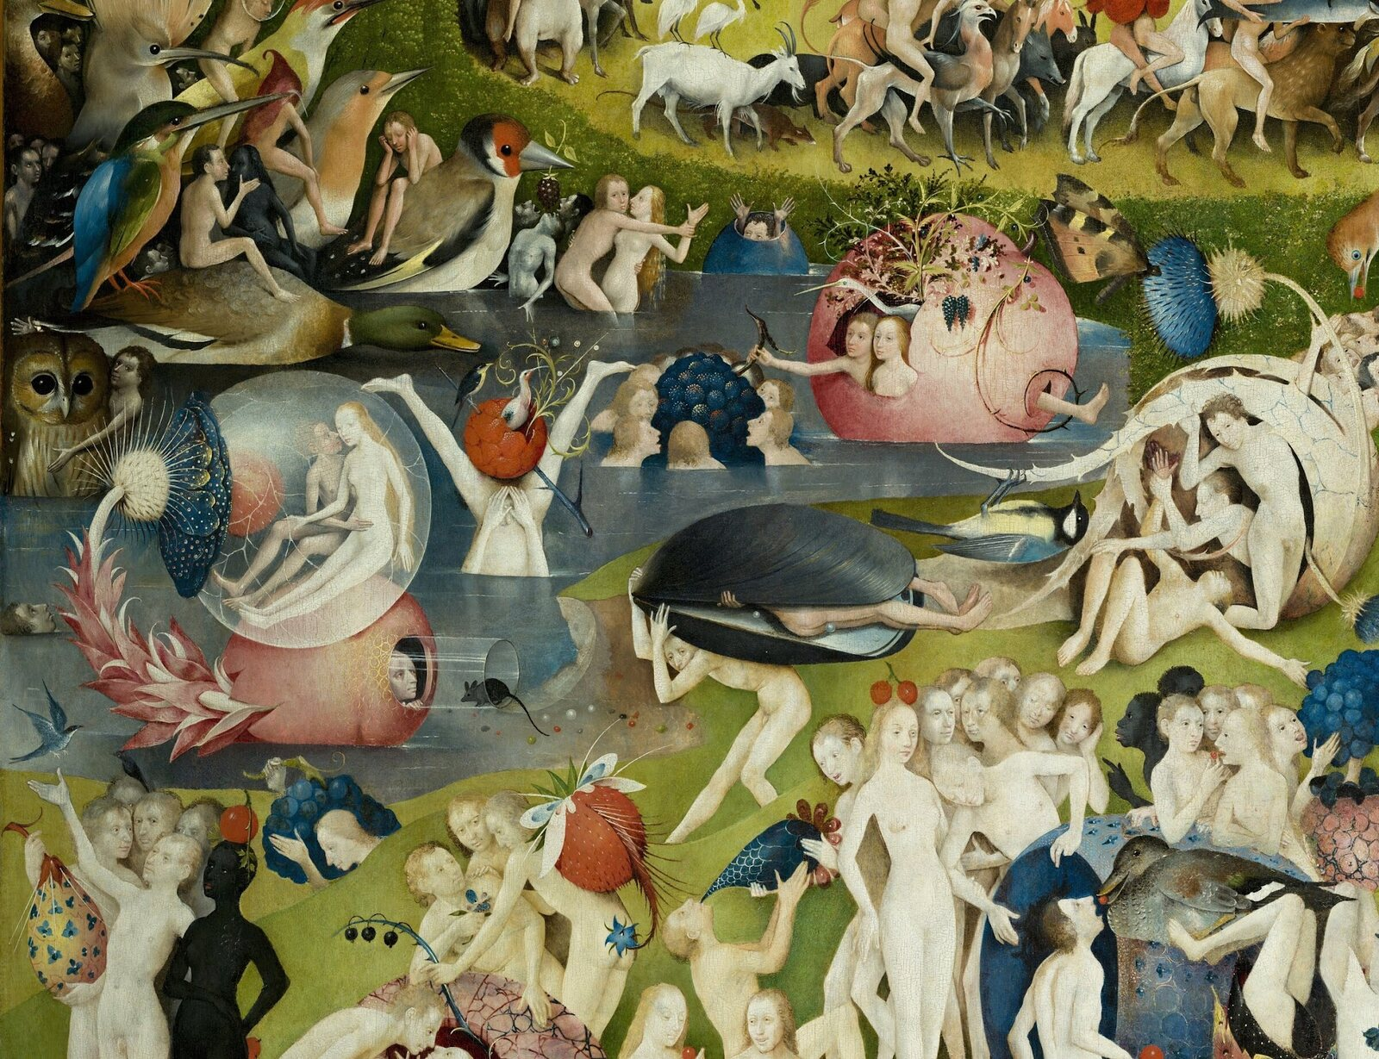
07 | REVERSAL OF SCALE
08
When Fruit Becomes Large Enough to Rule Us
Humans no longer master nature; perishable pleasure carries them.
Berries, birds, and shells exceed human scale
Bodies are enclosed, pressed, swallowed, and transported
Early inventories foregrounded the madroño fruit
Center panel | oversized fruit and bodily play
Humans no longer master nature; perishable pleasure carries them.
MASTERS & MASTERPIECES
Notes:
The first unsettling structure of the central garden is reversed scale. Berries grow large enough to enclose or overwhelm people. Birds and shells become inhabitable containers. Individual figures seem to use fruit, yet the composition makes fruit appear to carry, cover, and govern the body. Early Spanish inventories used the word madroño, the strawberry-tree fruit, as a name for the work, proving how conspicuous fruit was to early viewers. But reducing every berry to a rigid symbol of lust misses the larger problem of transience, decay, and pleasure without measure.
[Sources]
- https://docs.google.com/document/d/1Vjy7zvqamZy86taq1dsKhdKd97FuGD-3J8yaHpLhkm0/edit
- https://www.museodelprado.es/en/the-collection/art-work/the-garden-of-earthly-delights-triptych/02388242-6d6a-4e9e-a992-e1311eab3609
- Background: OpenAI ImageGen, generated from the user's Bosch-inspired visual direction; not a reproduction of an existing artwork.

Slide 9
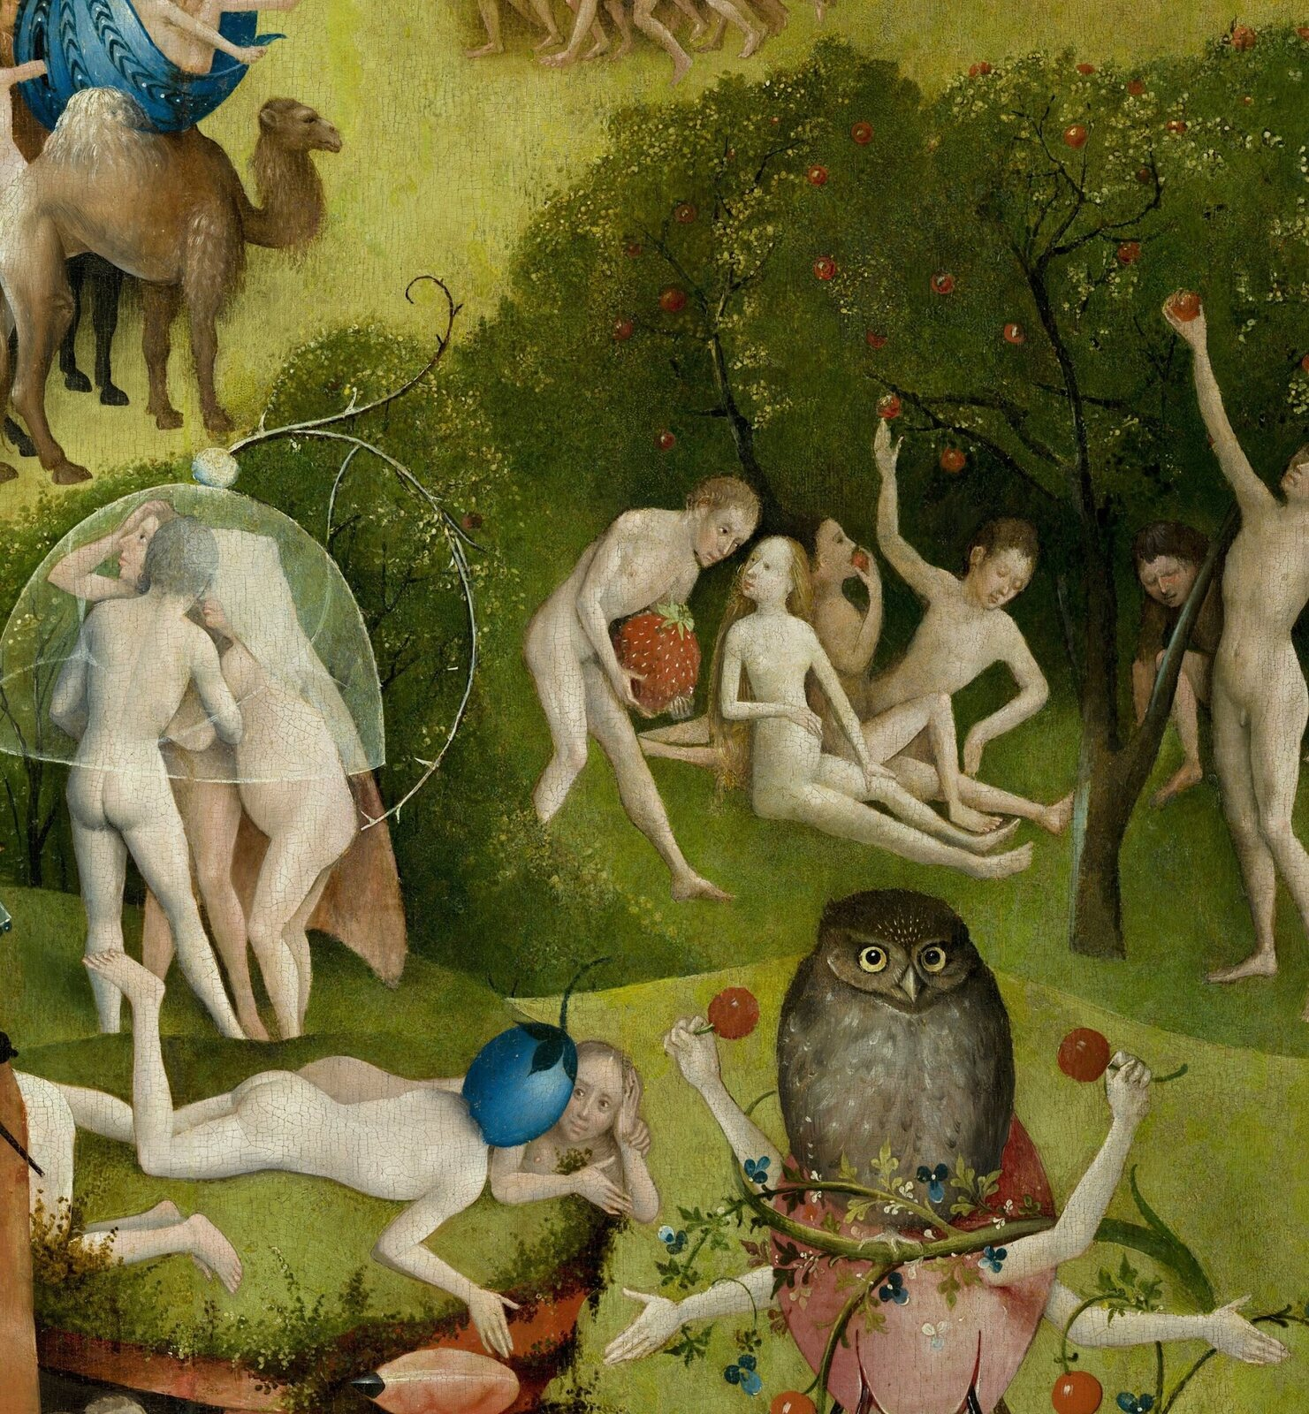
08 | FRAGILE ENCLOSURE
09
Intimacy Inside a Transparent Sphere
Pleasure appears protected while displaying its fragility.
A glass-like membrane encloses two bodies
Intimacy is protected and exposed
Spheres, skins, tubes, and shells recur across the panel
Center panel | couple in a transparent sphere
Pleasure appears protected while displaying its fragility.
MASTERS & MASTERPIECES
Notes:
The couple inside the transparent sphere seems briefly protected from the world and displayed before us at the same time. The enclosure creates a boundary, yet it looks thin enough to break. Intimacy therefore becomes secure, exposed, and temporary all at once. Similar spheres, membranes, tubes, fruit skins, and shells recur across the central panel. They may not share one fixed symbolic meaning, but together they create a material argument: pleasure can enclose the human body, yet it cannot preserve it forever.
[Sources]
- https://docs.google.com/document/d/1Vjy7zvqamZy86taq1dsKhdKd97FuGD-3J8yaHpLhkm0/edit
- https://www.museodelprado.es/en/the-collection/art-work/the-garden-of-earthly-delights-triptych/02388242-6d6a-4e9e-a992-e1311eab3609
- Background: OpenAI ImageGen, generated from the user's Bosch-inspired visual direction; not a reproduction of an existing artwork.

Slide 10
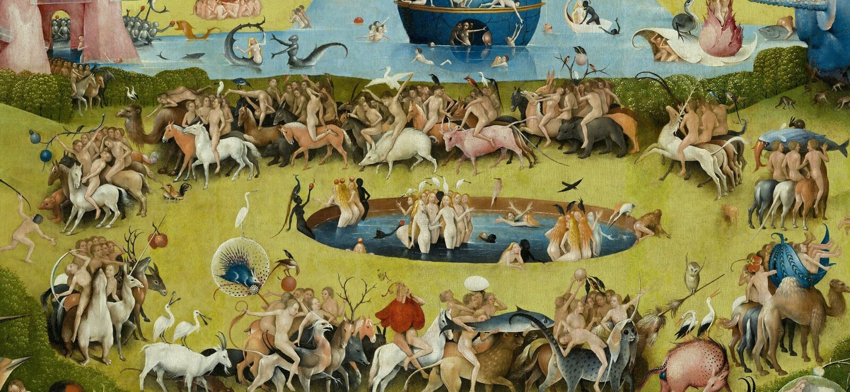
09 | THE CYCLE OF DESIRE
10
Do the Riders Truly Control the Animals?
Center panel | circular pool and mounted procession
Those who appear to master instinct may already be carried by it.
Men ride horses, cattle, camels, pigs, and hybrids
The procession circles a pool without end
There is constant motion but no destination
Those who appear to master instinct may already be carried by it.
MASTERS & MASTERPIECES
Notes:
Around the circular pool, men ride horses, cattle, camels, pigs, and fantastic animals. Viewed one by one, the riders seem to control the creatures. Seen as a whole, the circular movement suggests that instinct is carrying the humans. The panel contains enormous activity, but the procession has no exit and no destination. This repetition offers a powerful model of desire: each pursuit produces another pursuit, and pleasure becomes not an arrival but an endless circuit.
[Sources]
- https://docs.google.com/document/d/1Vjy7zvqamZy86taq1dsKhdKd97FuGD-3J8yaHpLhkm0/edit
- https://www.museodelprado.es/en/the-collection/art-work/the-garden-of-earthly-delights-triptych/02388242-6d6a-4e9e-a992-e1311eab3609
- Background: OpenAI ImageGen, generated from the user's Bosch-inspired visual direction; not a reproduction of an existing artwork.

Slide 11
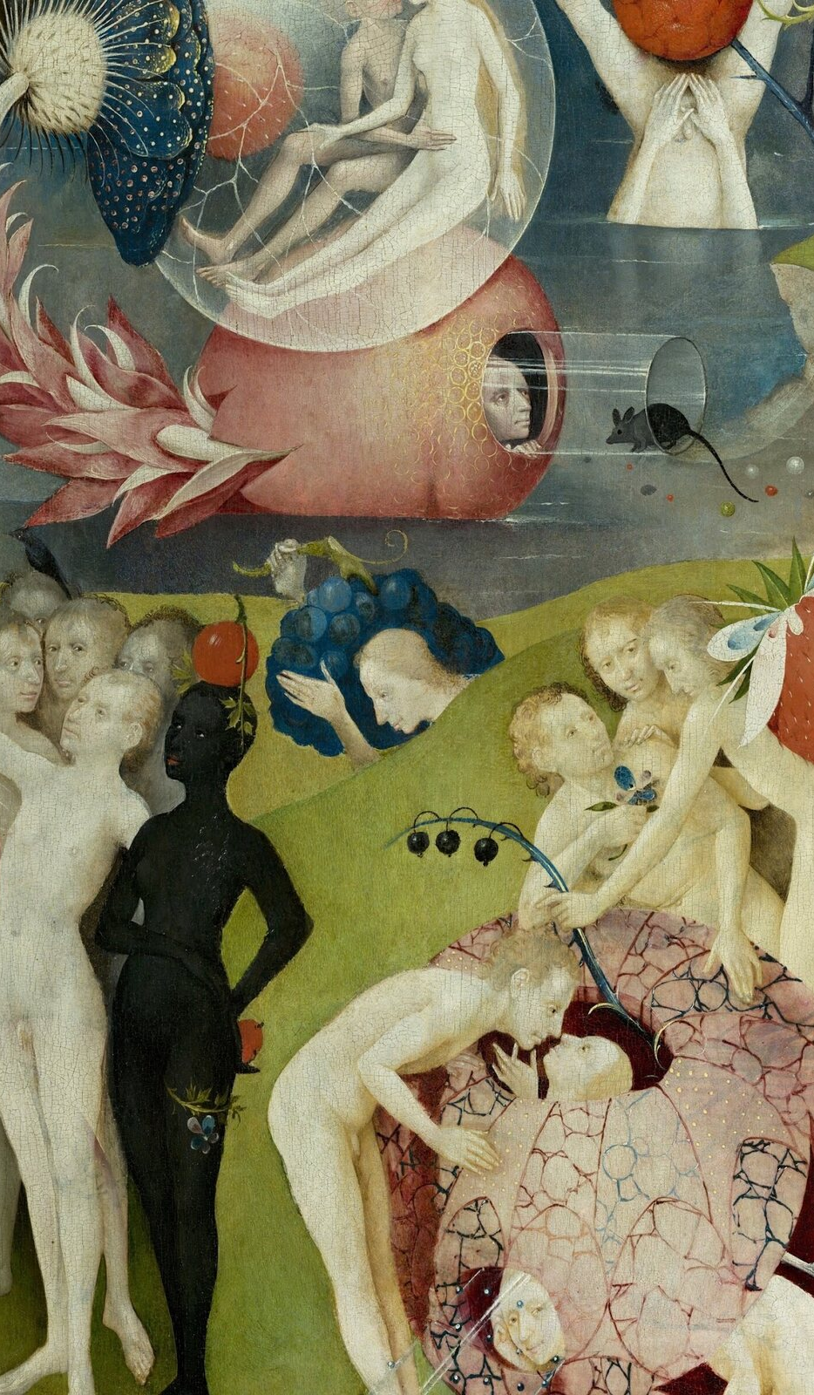
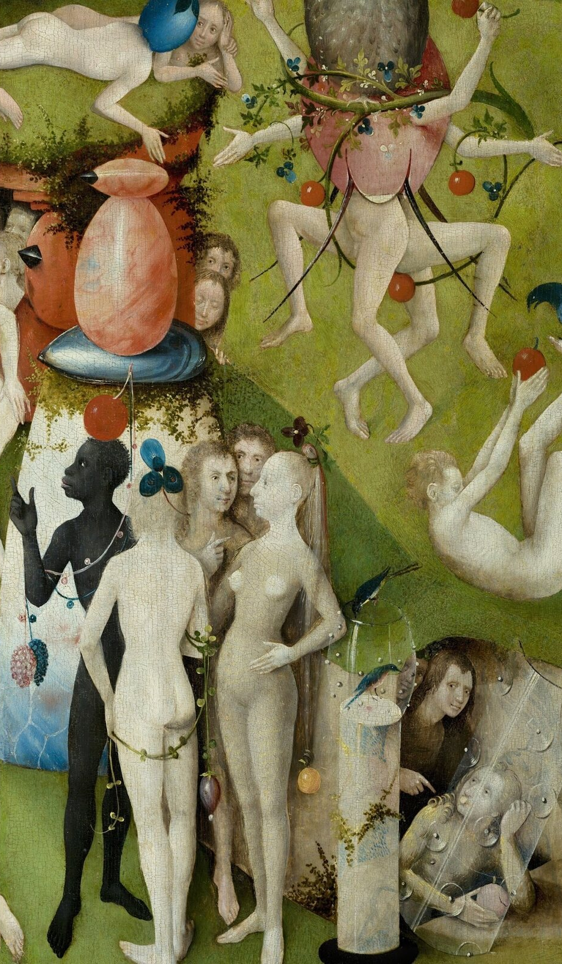
10 | WHO IS WATCHING WHOM?
11
Unfamiliar Bodies and the Man Who Looks Back
We watch desire—then discover that the painting is watching us.
Dark-skinned and hairy figures require full context
Modern ethnic identities should not be imposed without evidence
The outward-looking man's identity remains uncertain
Center panel | figures in context + outward-looking man
We watch desire—then discover that the painting is watching us.
MASTERS & MASTERPIECES
Notes:
The central panel includes dark-skinned and hairy figures that may relate to exotic geography, primordial humanity, the European wild-person tradition, and expanding knowledge of the world. They should not be isolated as curiosities or assigned precise modern identities without focused scholarship. At the lower right, a man looks directly out of the painting. He has been called Adam, Bosch, a patron, or a witness, but none is secure. His gaze reverses our position: while we inspect the desires of others, someone inside the image appears to notice us.
[Sources]
- https://docs.google.com/document/d/1Vjy7zvqamZy86taq1dsKhdKd97FuGD-3J8yaHpLhkm0/edit
- https://www.museodelprado.es/en/the-collection/art-work/the-garden-of-earthly-delights-triptych/02388242-6d6a-4e9e-a992-e1311eab3609
- Background: OpenAI ImageGen, generated from the user's Bosch-inspired visual direction; not a reproduction of an existing artwork.

Slide 12
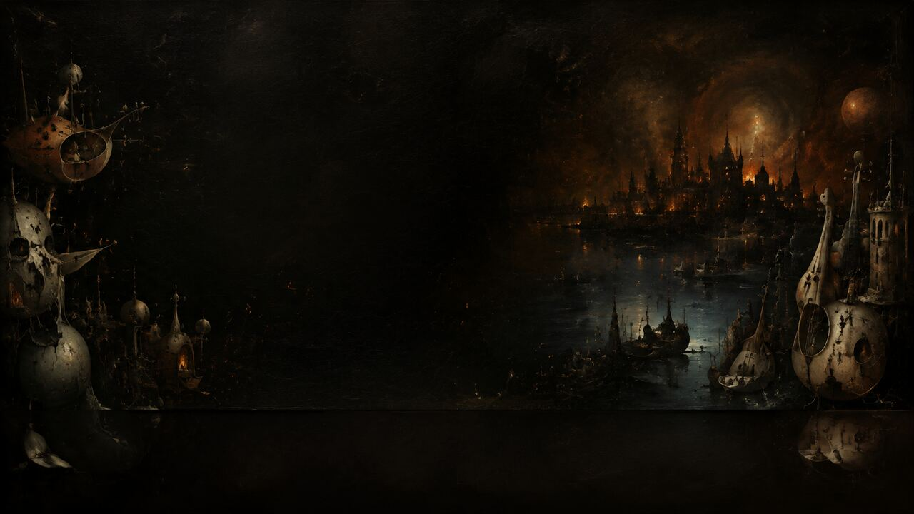
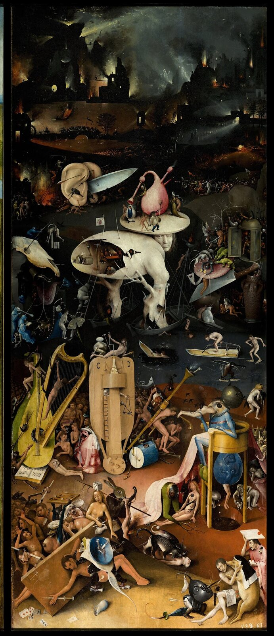
11 | MUSICAL HELL
12
Pleasure's Tools Begin to Use Their Users
The garden's pleasures survive, but they change from servants into masters.
Tender green and daylight become fire, ice, and darkness
Bodies are controlled by instruments, objects, and animals
Hell is the central garden turned inside out
Right panel | Musical Hell
The garden's pleasures survive, but they change from servants into masters.
MASTERS & MASTERPIECES
Notes:
The right panel first breaks with the garden through color. Tender green and daylight give way to brown-black darkness, cold blue ice, and burning cities. The foreground is not an abstract sea of flames but a punishment machine assembled from human culture. Instruments, dice, drinking vessels, documents, animals, and sensory organs take control. The pleasures of the center have not vanished. Their relationship to the body has reversed. Food no longer nourishes, music no longer harmonizes, and the body no longer belongs to itself.
[Sources]
- https://docs.google.com/document/d/1Vjy7zvqamZy86taq1dsKhdKd97FuGD-3J8yaHpLhkm0/edit
- https://www.museodelprado.es/en/the-collection/art-work/the-garden-of-earthly-delights-triptych/02388242-6d6a-4e9e-a992-e1311eab3609
- Background: OpenAI ImageGen, generated from the user's Bosch-inspired visual direction; not a reproduction of an existing artwork.

Slide 13
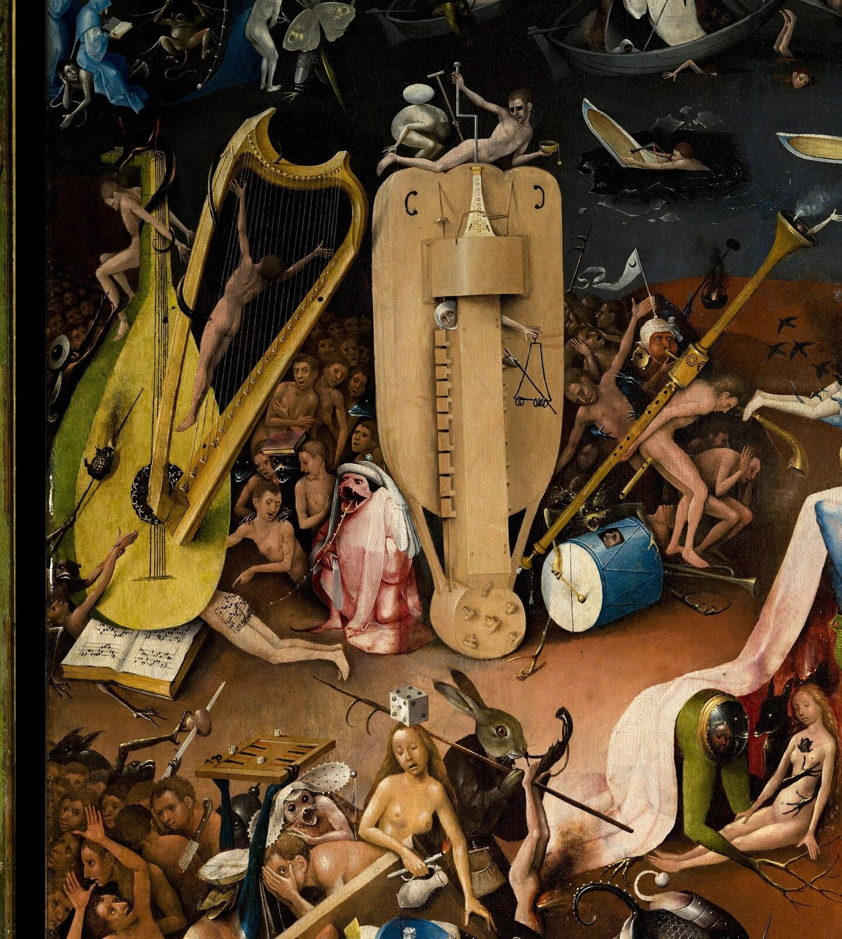
12 | WHEN INSTRUMENTS PLAY PEOPLE
13
Machines of Harmony Become Machines of Shame
Bosch's instruments of punishment are disturbingly familiar.
Sinners are stretched across harp strings and crushed by a lute
Drums, pipes, and notation reorganize the body
The buttocks score reverses entertainment into humiliation
Right panel | instruments and buttocks-score area
Bosch's instruments of punishment are disturbingly familiar.
MASTERS & MASTERPIECES
Notes:
Musical Hell is disturbing because its instruments of punishment are familiar forms of entertainment. Sinners are stretched between harp strings and crushed beneath an enormous lute. Drums and pipes no longer support dancing or feasting; they turn human bodies into playable material. The musical notation across a pair of buttocks has been performed in the digital age, but within the painting it first functions as a reversal. Marks that should organize harmony become evidence of exposure, humiliation, and lost agency.
[Sources]
- https://docs.google.com/document/d/1Vjy7zvqamZy86taq1dsKhdKd97FuGD-3J8yaHpLhkm0/edit
- https://www.museodelprado.es/en/the-collection/art-work/the-garden-of-earthly-delights-triptych/02388242-6d6a-4e9e-a992-e1311eab3609
- Background: OpenAI ImageGen, generated from the user's Bosch-inspired visual direction; not a reproduction of an existing artwork.

Slide 14
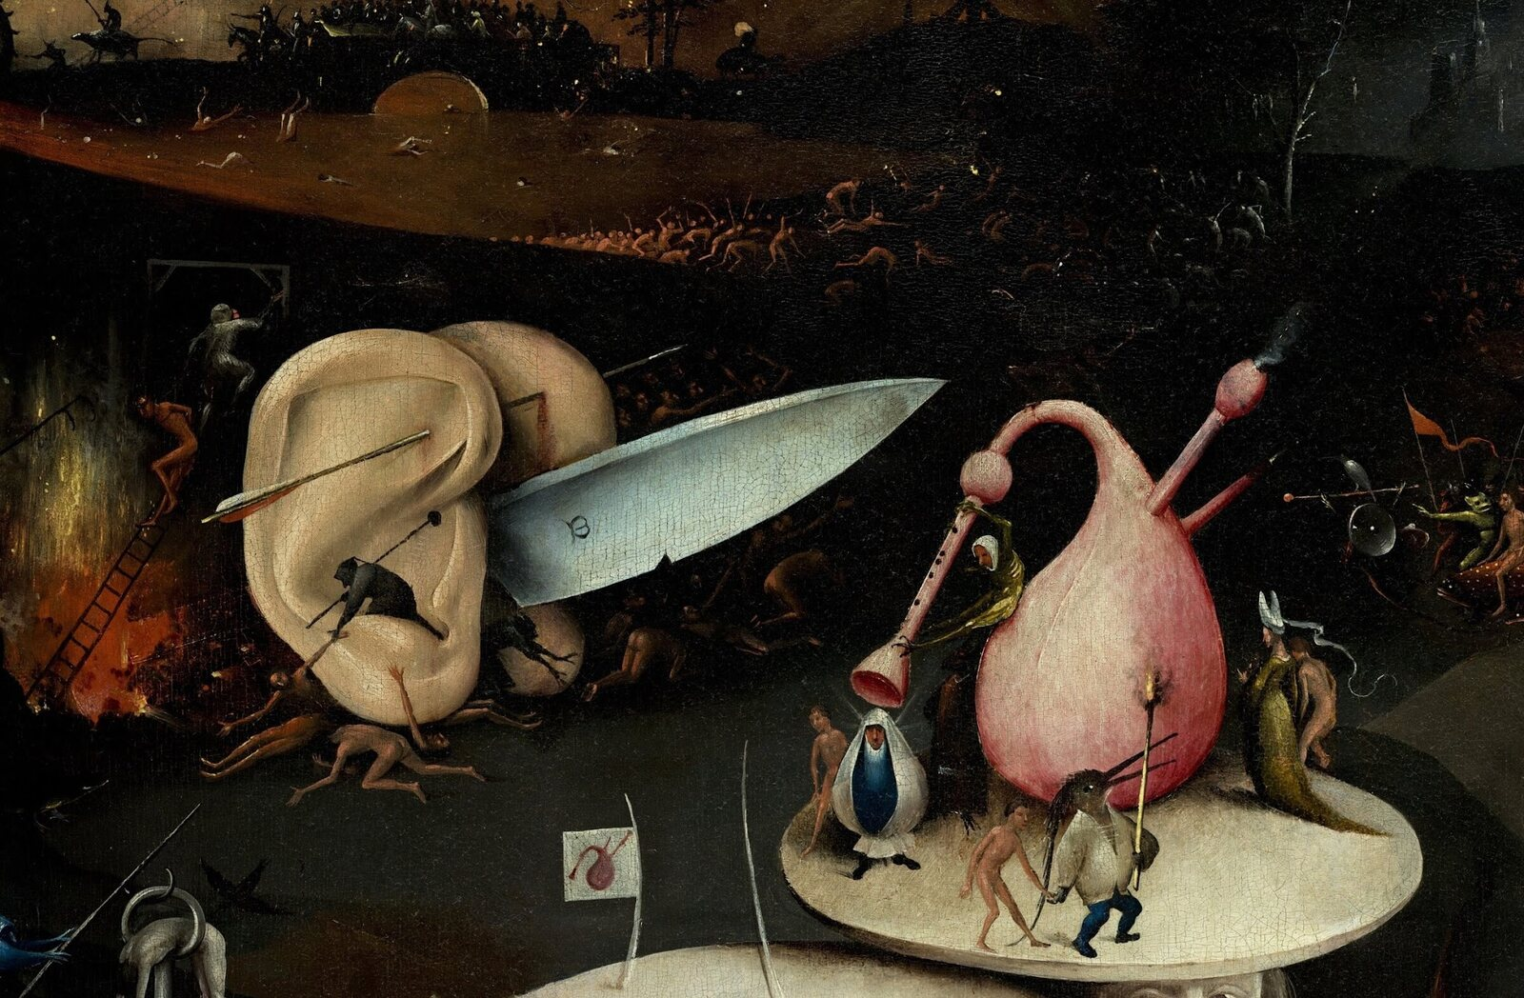
13 | THE SENSES BECOME WEAPONS
14
Giant Ears and the M-Marked Blade
Right panel | giant ears and M-marked blade
An organ made for listening is rebuilt as a machine of violence.
Two giant ears are pierced and joined to a blade
Sense organ and weapon become one hybrid
The meaning of the letter M is not securely known
An organ made for listening is rebuilt as a machine of violence.
MASTERS & MASTERPIECES
Notes:
Two enormous ears are pierced by an arrow and joined around a giant blade, turning a sensory organ into an impossible but threatening machine. Ears once received music and language; here they can only participate in violence. The letter M on the blade has been read as a maker's mark, a personal initial, or something else, but its meaning remains insecure. More important than solving the letter is following the transformation: in the center people seek sensory stimulation; in Hell the senses themselves administer punishment.
[Sources]
- https://docs.google.com/document/d/1Vjy7zvqamZy86taq1dsKhdKd97FuGD-3J8yaHpLhkm0/edit
- https://www.museodelprado.es/en/the-collection/art-work/the-garden-of-earthly-delights-triptych/02388242-6d6a-4e9e-a992-e1311eab3609
- Background: OpenAI ImageGen, generated from the user's Bosch-inspired visual direction; not a reproduction of an existing artwork.

Slide 15
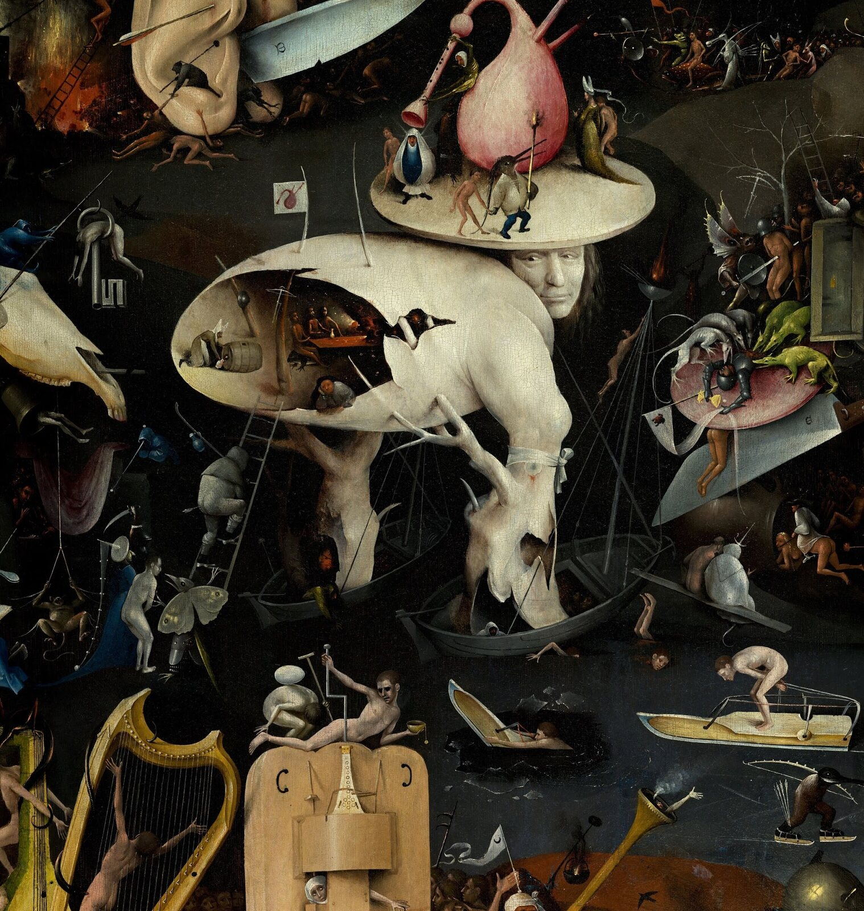
14 | HOW A MONSTER WAS MADE
15
Tree-Man: Person, Dead Tree, Tavern, and Landscape
The monster feels real because every impossible part is concrete.
Face, dead wood, shell, tavern, boats, and landscape merge
Oil paint makes skin, wood, ice, and metal tactile
The face is not a confirmed Bosch self-portrait
Right panel | Tree-Man
The monster feels real because every impossible part is concrete.
MASTERS & MASTERPIECES
Notes:
The Tree-Man is simultaneously a person, dead tree, hollow shell, tavern, boat, and landscape. Bosch's monsters feel convincing not because they are vague, but because every impossible component appears materially specific. Skin, wood, ice, metal, and brittle shell each possess a distinct texture. Technical study also reveals changes between underdrawing and finished paint, suggesting that local inventions developed as Bosch worked. The Tree-Man's face is often called a self-portrait, but there is no secure evidence for that appealing identification.
[Sources]
- https://docs.google.com/document/d/1Vjy7zvqamZy86taq1dsKhdKd97FuGD-3J8yaHpLhkm0/edit
- https://www.museodelprado.es/en/the-collection/art-work/the-garden-of-earthly-delights-triptych/02388242-6d6a-4e9e-a992-e1311eab3609
- https://boschproject.org/
- Background: OpenAI ImageGen, generated from the user's Bosch-inspired visual direction; not a reproduction of an existing artwork.

Slide 16
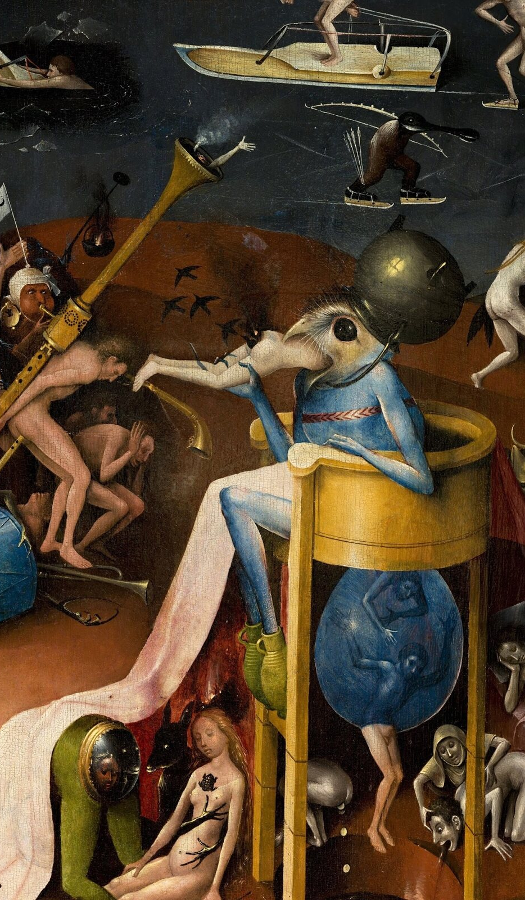
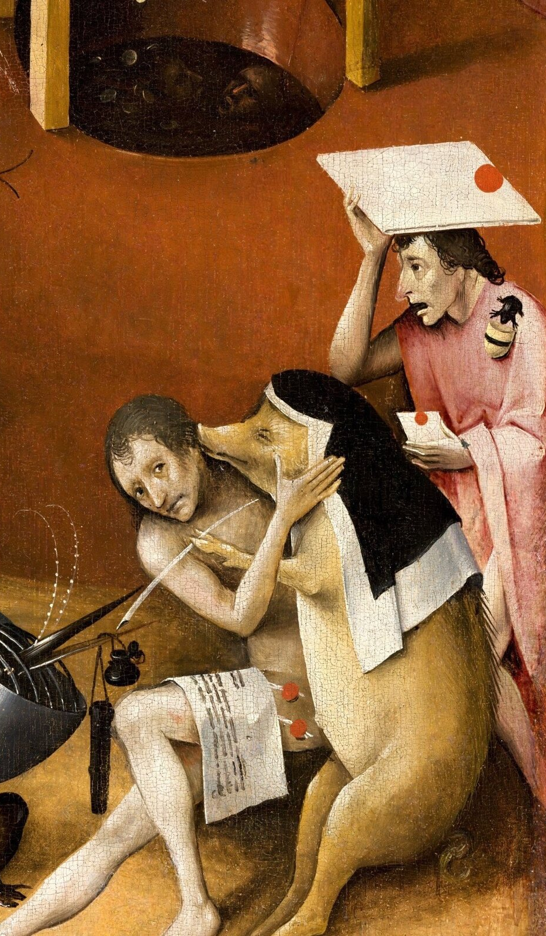
15 | SWALLOWING AND EXCRETION
16
The Bird-Headed Monster and the Nun-Pig
Power, appetite, law, and religious costume fuse into absurd machines.
The bird-headed figure swallows and excretes sinners
A nun-pig pressures a man to sign a document
Animals repeatedly reverse their relationship to humans
Right panel | bird-headed monster + nun-pig and contract
Power, appetite, law, and religious costume fuse into absurd machines.
MASTERS & MASTERPIECES
Notes:
The bird-headed monster sits on a toilet-like throne, swallowing and excreting sinners. Appetite, power, and endless consumption become an absurd machine. The popular name Prince of Hell is modern convenience, not Bosch's title. Nearby, a pig dressed as a nun pressures a man to sign a document, fusing religious costume, law, greed, and bodily coercion. Rabbits and other animals also dominate human beings. The common rule of Bosch's Hell is not one monster or one sin; it is the reversal of every familiar subject-object relationship.
[Sources]
- https://docs.google.com/document/d/1Vjy7zvqamZy86taq1dsKhdKd97FuGD-3J8yaHpLhkm0/edit
- https://www.museodelprado.es/en/the-collection/art-work/the-garden-of-earthly-delights-triptych/02388242-6d6a-4e9e-a992-e1311eab3609
- Background: OpenAI ImageGen, generated from the user's Bosch-inspired visual direction; not a reproduction of an existing artwork.

Slide 17
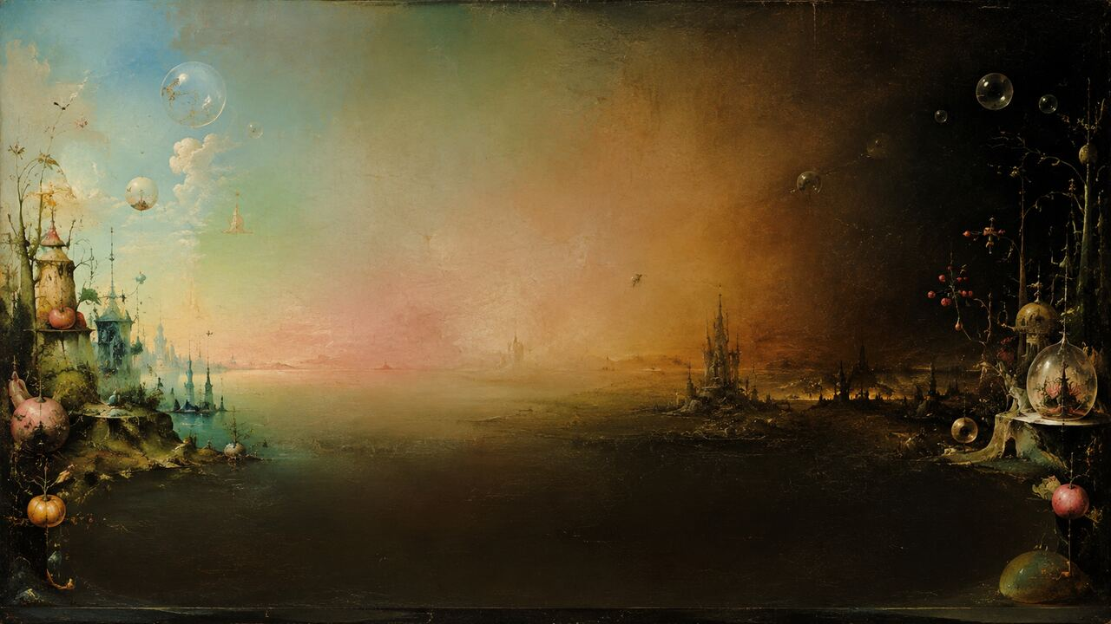
16 | A MORAL MACHINE WITHOUT ONE ANSWER
17
Is the Central Garden Paradise—or a Trap?
Uncertainty is not a failure of scholarship; it is part of the viewer's position.
MORAL WARNING
UNFALLEN WORLD
COURTLY CONVERSATION
Moral warning | sensual excess leads toward Hell
Unfallen or pre-civilized world | no obvious pain or hierarchy
Courtly conversation object | entertainment, debate, and warning coexist
Fraenger's Adamite theory was influential but lacks reliable documentary proof
Uncertainty is not a failure of scholarship; it is part of the viewer's position.
MASTERS & MASTERPIECES
Notes:
The most durable reading is moral warning: Creation on the left, sensual excess in the center, and consequence on the right. Another interpretation sees the center's lack of illness, old age, labor, and hierarchy as unfallen or pre-civilized humanity. Wilhelm Fraenger's theory of Adamites and secret erotic ritual became influential, but reliable documents do not support it. A more productive approach treats the triptych as a courtly conversation object, where entertainment, learned recognition, and moral warning coexist. Any persuasive reading must explain the closed exterior, the beauty of the center, and the reversals of Hell together.
[Sources]
- https://www.museodelprado.es/en/the-collection/art-work/the-garden-of-earthly-delights-triptych/02388242-6d6a-4e9e-a992-e1311eab3609
- https://www.huygens.knaw.nl/en/resources/boschdoc-2/
- Background: OpenAI ImageGen, generated from the user's Bosch-inspired visual direction; not a reproduction of an existing artwork.

Slide 18
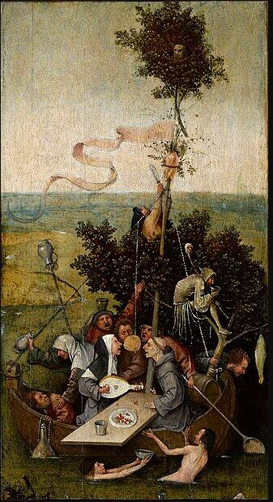
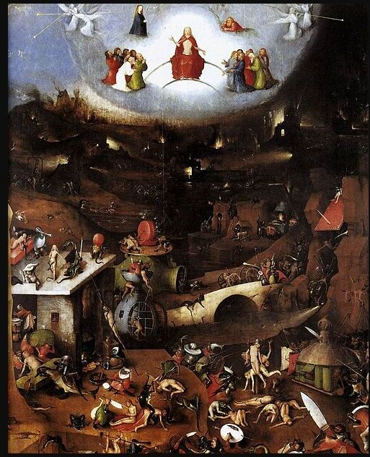
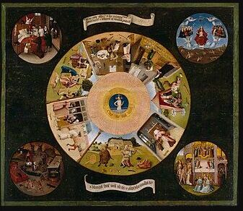
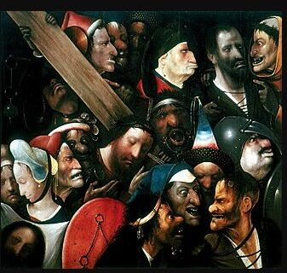
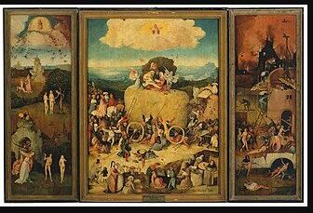
17 | OTHER FANTASTICAL WORLDS
18
Fantasy Is Bosch's Recurring Moral Language
Seven Deadly Sins
Ship of Fools
Last Judgment
Christ Carrying the Cross
Haywain Triptych
Moral surveillance
Collective folly
Cosmic collapse
Cruelty closes in
The scramble for gain
Desire, folly, and consequence keep moving humanity forward.
Dates and attributions remain debated for several works
Desire, folly, and consequence keep moving humanity forward.
MASTERS & MASTERPIECES
Notes:
The Garden of Earthly Delights is not an isolated eruption of Bosch's imagination. The Seven Deadly Sins and the Four Last Things arranges ordinary wrongdoing like an eye watching the world. Ship of Fools traps a drinking, singing, grasping group in a vessel that no one truly steers. The Vienna Last Judgment expands the whole world into a landscape of fall and punishment. In Christ Carrying the Cross, grotesque faces press tightly around Christ; the Ghent painting is now often described cautiously as the work of a Bosch follower or related workshop. The Haywain Triptych sends every social rank scrambling after a cart of hay that cannot last. Across these works, fantasy is not decoration. It makes folly, greed, cruelty, and consequence visible.
[Sources]
- https://commons.wikimedia.org/wiki/File:Hieronymus_Bosch-_The_Seven_Deadly_Sins_and_the_Four_Last_Things.JPG
- https://commons.wikimedia.org/wiki/File:Jheronimus_Bosch_011.jpg
- https://commons.wikimedia.org/wiki/File:Hieronymus_Bosch,_The_Last_Judgment.JPG
- https://commons.wikimedia.org/wiki/File:Jheronimus_Bosch_or_follower_001.jpg
- https://commons.wikimedia.org/wiki/File:Bosch_-_Haywain_Triptych.jpg
- https://boschproject.org/
- Background: OpenAI ImageGen, generated from the user's Bosch-inspired visual direction; not a reproduction of an existing artwork.

Slide 19
18 | HOW THE TRIPTYCH REACHED US
19
From the Nassau Palace to the Prado—and Back to Silence
See the whole, approach the details, then return to the whole.
1517
1591/93
1933–43
TODAY
1517 | earliest secure record in the Nassau Palace
1591/1593 | acquired by Philip II and sent to El Escorial
1933–1943 | restoration, custody, and permanent loan to the Prado
Today | follow pleasure as it changes into control
Owned by Patrimonio Nacional and on permanent loan to the Prado; verify current gallery information
See the whole, approach the details, then return to the whole.
MASTERS & MASTERPIECES
Notes:
The triptych was in the Nassau Palace by 1517. Philip II acquired it in 1591 and sent it to El Escorial in 1593. In the 1930s it went to the Prado for restoration and safekeeping, and a 1943 document established the permanent loan. It remains legally owned by Patrimonio Nacional. In front of the original, begin far enough away to see all three panels. Then trace water, spheres, fruit, animals, and instruments as pleasure changes into control. Move close, and finally step back again. When the shutters close, hundreds of voices disappear, but Bosch's question returns to the viewer.
[Sources]
- https://www.museodelprado.es/en/the-collection/art-work/the-garden-of-earthly-delights-triptych/02388242-6d6a-4e9e-a992-e1311eab3609
- https://www.museodelprado.es/en/resource/restoration-of-the-garden-of-earthly-delights/98d5fd6c-2dcf-4c37-8bdc-a05df5b69cfe
- Background: OpenAI ImageGen, generated from the user's Bosch-inspired visual direction; not a reproduction of an existing artwork.

Slide 20

Notes:
This is Masters and Masterpieces. If you enjoy looking again through visual detail and evidence, subscribe, share, and join us for the next work.
[Sources]
- Channel end card; no external sources.
- Background: OpenAI ImageGen, generated from the user's Bosch-inspired visual direction; not a reproduction of an existing artwork.

